Slide 1

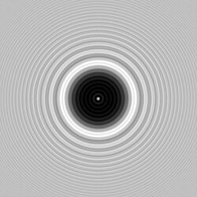
SIMULATION OF FRESNEL DIFFRACTION BY AN OPAQUE DISC
The Poisson-Arago Spot
A computational study using Python, NumPy and Matplotlib
Presented by:
Akshara Karri (2501PH13)
Varkatam Akshaya (2501PH12)
Badavath Madhulatha (2501PH38)
Tejeswin R (2501PH09)
EP2102 :OPTICS & LASERS

Slide 2
Why a Bright Spot at the centre of a shadow?
What we usually expect
When light falls on an opaque circular disc,the disc to block the light and produce a completely dark circular shadow on the screen behind it.
|
|
|
|
What actually happens
Light behaves as a wave. When light encounters the edge of the opaque disc, it undergoes diffraction, light waves bend and spread into the geometrical shadow region.

Slide 3
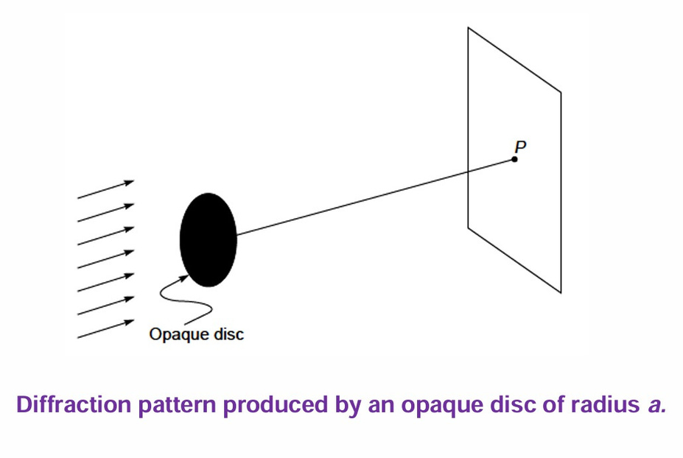
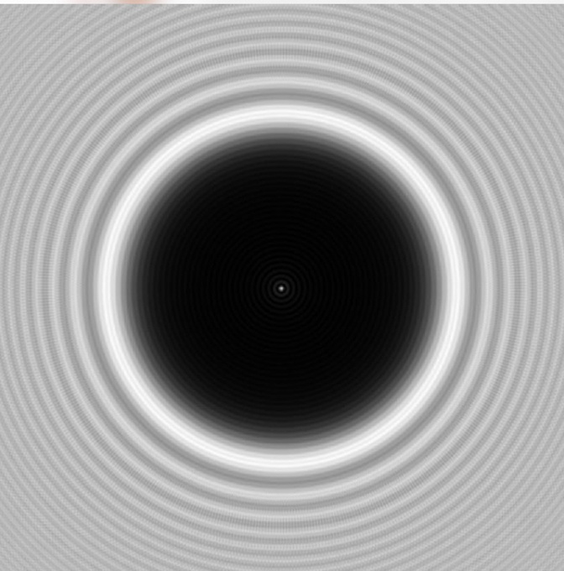
According to the Huygens–Fresnel principle, every point on the unobstructed part of the wavefront acts as a source of secondary wavelets.
These wavelets travel into the shadow region and interfere with one another. As a result, a bright spot appears at the center of the disc's shadow, known as the Poisson–Arago spot.

Slide 4

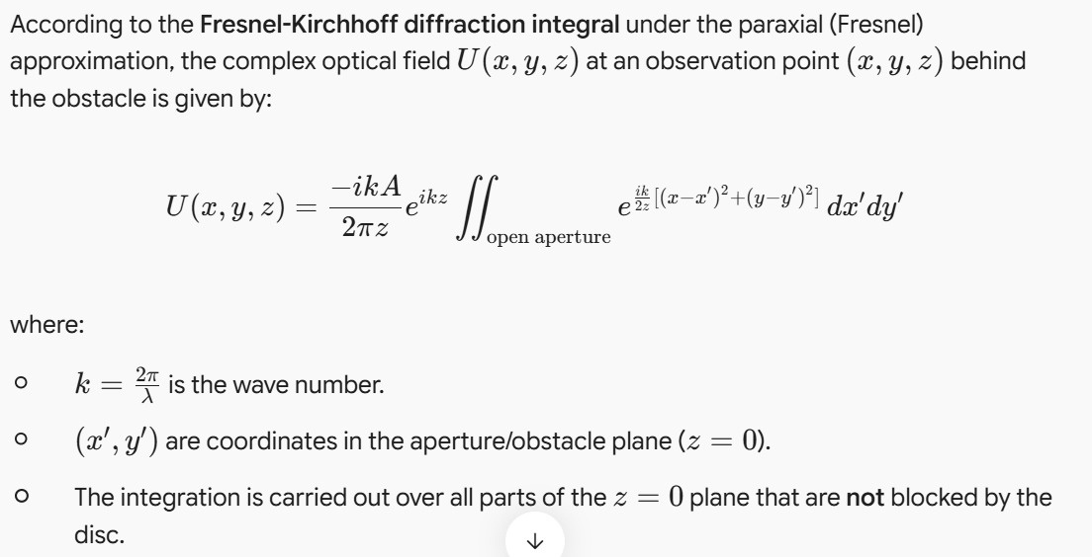
The Fresnel Approximation:

Slide 5

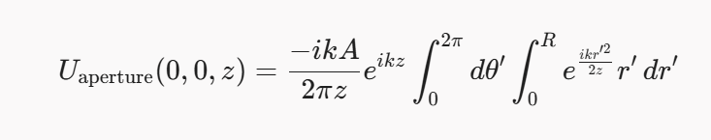

Apply Babinet’s Principle:
Instead of integrating over the infinite region outside the disc, the field behind the opaque disc can be found by Babinet’s Principle :
Field for Circular Aperture:
Evaluating the integral:

Slide 6
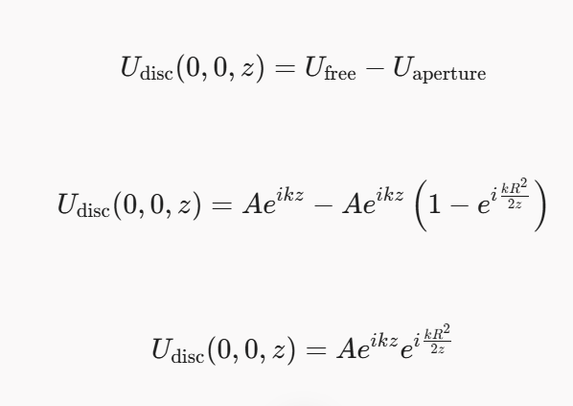
Combining for the Opaque Disc:
Now substitute U_aperture back into Babinet’s equation to find the field behind the opaque disc at the center of the shadow

Slide 7
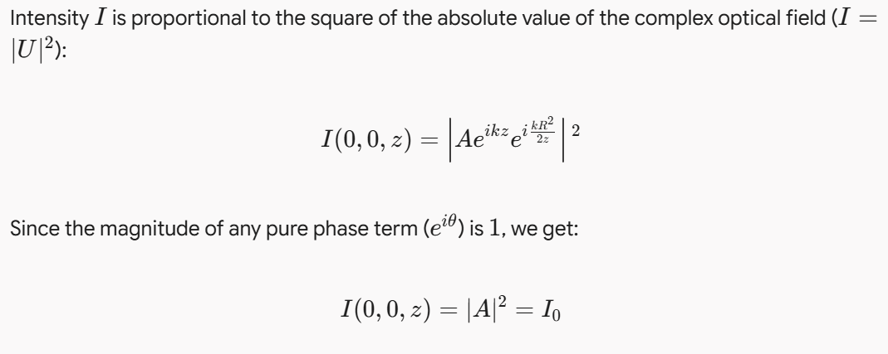
Calculating the Intensity (The Poisson Spot Formula):
The mathematical result reveals that the intensity right at the exact center of the geometrical shadow (x=0, y=0) is equal to Io—the exact same intensity as the unobstructed incident wave!

Slide 8
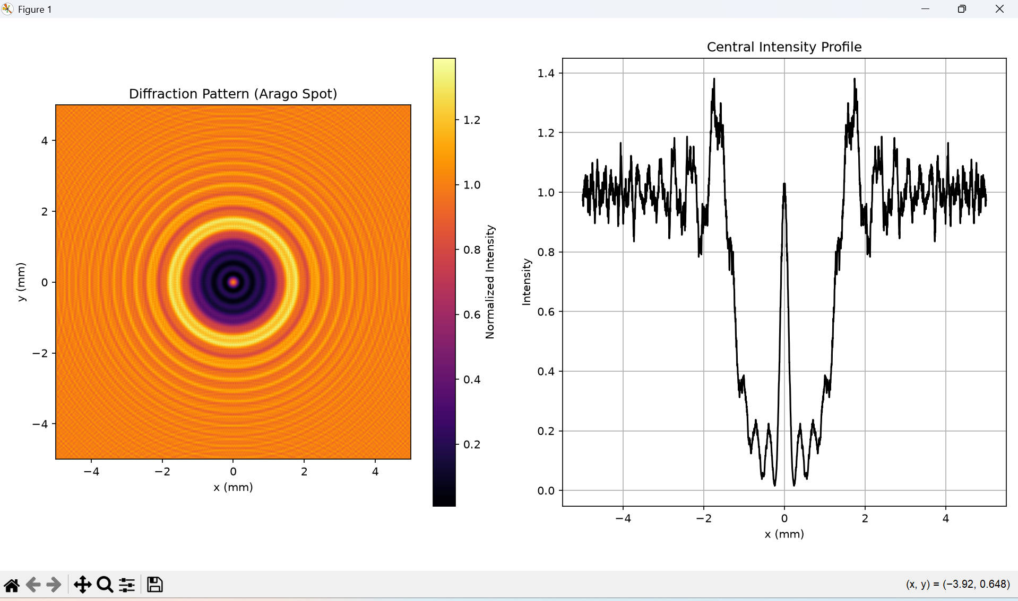
Simulation Results :

Slide 9
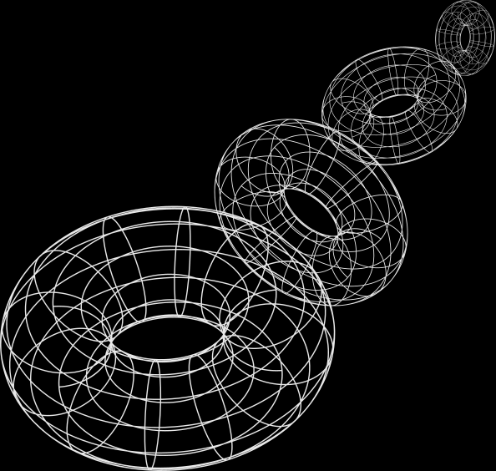
Analysis:
Numerical Method: Implemented the Angular Spectrum Method via 2D Fast Fourier Transforms (FFT) in Python.
Physical Parameters: Simulated a red He-Ne laser (lambda = 632.8) past a 1.0mm radius opaque disc at a propagation distance of z = 1.0m.
2D Diffraction Map: Successfully visualizes the circular geometric shadow enclosed by concentric Fresnel diffraction rings.
1D Intensity Profile: Confirms a sharp, prominent intensity peak (I/I_0 =approx 1.0) emerging precisely at the dead center (x = 0).

Slide 10
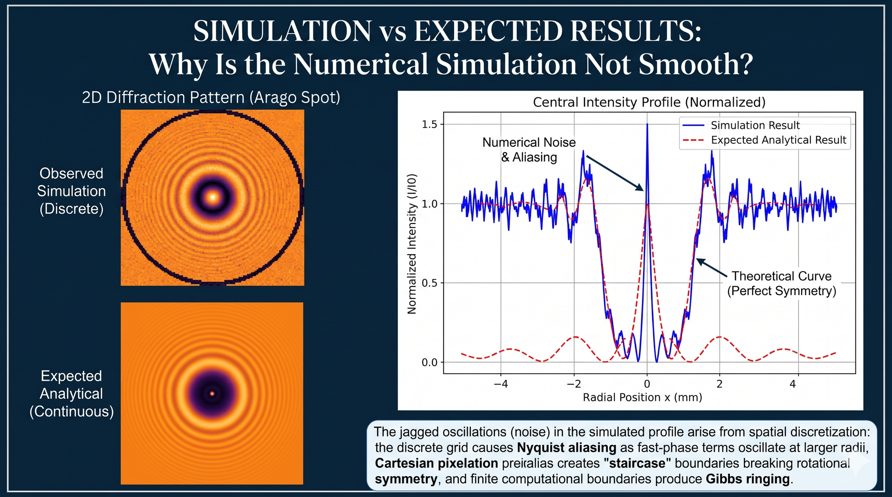

Slide 11
Conclusion :
Validation of Wave Theory: Numerical simulation using Babinet’s principle confirms that on-axis secondary wavelets interfere constructively, producing a central intensity equal to the unobstructed beam.
Geometric Sensitivity: The spot forms strictly due to rotational symmetry; non-circular obstacles disrupt equal optical path lengths, replacing the central peak with multi-lobed interference patterns.
Fresnel Scaling: Ring spacing and fringe visibility depend directly on the Fresnel number , verifying the paraxial diffraction model.

Slide 12
Applications:
The Aragoscope (Space Astronomy): Employs a large orbiting disc or occulter to diffract starlight into a central peak, functioning as an ultra-high-resolution diffractive telescope without heavy glass mirrors.
Optical Metrology & Precision Alignment: Since the spot is pinned exactly to the optical axis, it serves as a self-aligning laser reference for long-baseline particle accelerator and tunneling alignment.
Laser Beam Diagnostics & Collimation: Evaluates laser spatial coherence, wavefront sphericity, and edge sphericity of precision pinholes or spherical micro-targets.
Matter-Wave Interferometry: Demonstrates wave-particle duality by producing Arago spots using diffraction of large molecules (e.g., Fullerenes) and electrons.

Slide 13
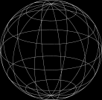
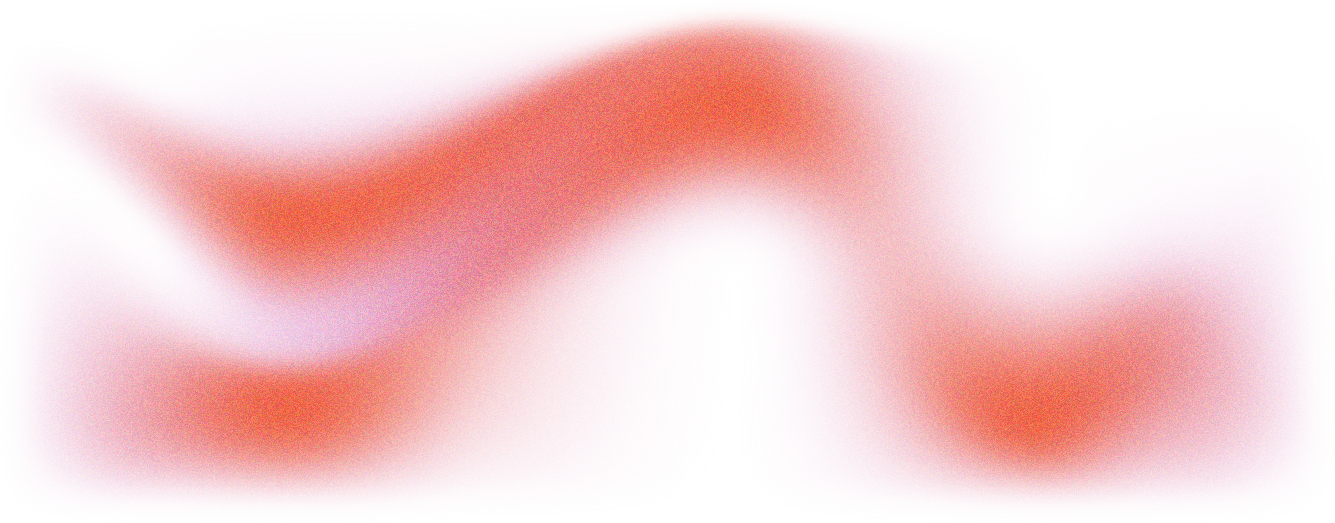
THANK
YOU

